Slide 1
Mini Project 3
HR Analytics – Employee Attrition Rate
By AJMAL M S

Slide 2
PROBLEM STATEMENT
Human Resources are pillar of any organization. Involving from hiring to firing, HR department take care of all employee related things.
In an organization, the time consumed is for hiring or retention process of work force.
This time consuming yet necessary job can be done efficiently using HR Analytics.
HR Analytics is a data set with over 30 characteristics, categorized by numeric and text data, and discrete.
With the advent of storing data in digital form and the realization of its value, a race has begun to automate many older systems in order to improve speed accuracy!
Automate an organization's system of hiring and firing. This is made possible with the help of data science and machine learning techniques.

Slide 3
LITERATURE SURVEY
REVIEW BASED ON RESEARCH PAPERS FROM 2021…

Slide 4
HR Analytics and Organizations
Organizations became very massive in this new era of technology. There is a necessary in hiring huge amount of people and processing a huge amount of data.
Through digitalization and an increase in work force, organizations are in need to use big data and predictive analysis.
This is in turn used to keep employee information up to date and predict about their future contribution to the company.
This is called employee attrition rates. Whether an employee will resign or not resign in coming how many years is all about “Attrition Rate”.
Analysing attrition rate would help the organization’s HR team a lot.
For example, if an employee is found to leave out, HR can consider another employee of same quality in a couple of days. This is possible through HR analytics
Unilever said that “HR analytics saves our time by more than two months” in a survey. [1]

Slide 5
HR analytics – Using strategy and KPI
HR analytics (HRA)on primary scale has been always done by strategy of one own organization.
Then on the next step, HRA started using Key Performance Indicators or KPI
KPI are basically an indicator methodology in management
Which analyses by only considering, which things matters the most in performance of an organization
It could be employee qualification, number of projects, number of products etc..

Slide 6
Industry 4.0 and HRA
Industry 4.0 is the new industrial revolution which includes all the new era discipline like Artificial Intelligence(AI), Big Data(BD) and Predictive Analysis (Machine Learning).
This plan is for connecting a Data Analyst and an HR professional below one umbrella for a better HRA process.
This process helps in employee turnover prediction and HR analytics too. HRA, rather than tool, it is an architecture, it is a plan.
HRA started gaining attention in industry after the development of the computers.
With the arrival of computers, the Human Resource Information systems (HRIS) became a fundamental system in enterprises [2].
HRIS first came into relevance in 1990s.

Slide 7
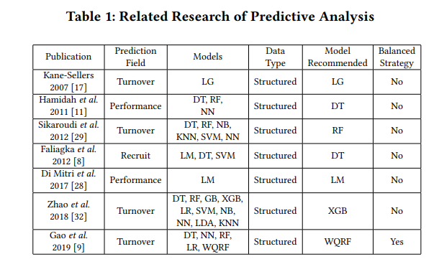
Related research and models of HRA

Slide 8
1. HRA, methodologies
The methodologies basically HRA follows and I used to follow are;
1- Collecting Data
The process of collecting data is so important in HRA. The primary data are like;
Employee profiles, performance, data on high-performers, data on low-performers, salary and promotion history, demographic data, on-boarding, training, engagement, retention, turnover, absenteeism
2 – Measurement
Secondly we have measurement. At the measurement stage, the data begins a process of continuous measurement and comparison, also known as HR metrics.
3 – Analysis
All the visual analysis like correlation, graphs would happen in this phase
4- Prediction
The final stage is predicting the attrition rates.

Slide 9

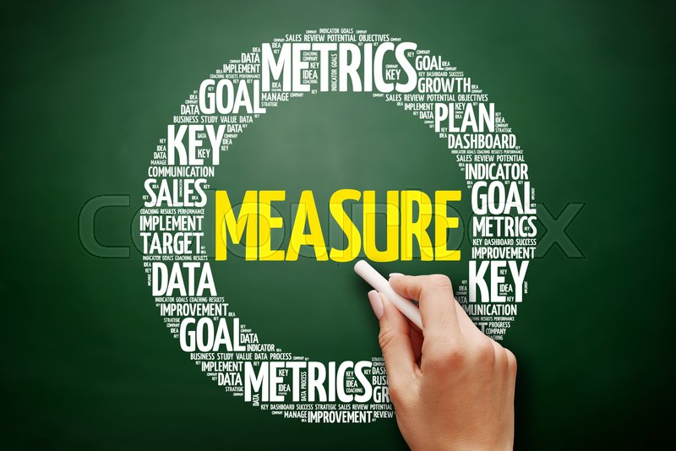
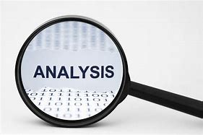

Methodologies Diagram

Slide 10
Methodologies diagram
Data Collection
Measurement
Analysis
Prediction

Slide 11
2. DATA SET AND TECHNIQUES USED
I utilized the dataset of IBM, about their employee data with the attributes like;
Age, Attrition, Business Travel
Daily Rate, Department, Distance From Home
Education, Employee Count, Employee
Environment Satisfaction, Gender, Job Involvement
Job , Job Role, Job Satisfaction
Marital Status, Monthly Income, Monthly Rate
Number of Companies Worked, Percent Salary Hike, Performance Rating
Relationship Satisfaction, Standard Hours, Stock Option Level
Total Working Years, Training Times Last Year, Work Life Balance
Years At Company, Years In Current Role, Years Since Last Promotion
Years as Manager.

Slide 12
2.1 – Techniques Used
All the techniques I used which are important for data analytics are:
Exploratory Data Analytics (EDA), Summary of EDA
Feature Engineering (Data Balancing using SMOTE and Data leakage), and Modelling.
Exploratory Data Analytics It’s a techniques also referred as EDA, which is utilized to represent the data and its relation in an illustrational manner
These are done using libraries of python language like pandas, Seaborn, Matplotlib and more.
Pandas - An open source widely used library used for data analysis. Used for writing and reading data from file sources and data handling.
Seaborn - Seaborn is a Python data visualization library based on matplotlib. It provides a high-level interface for drawing attractive and informative statistical graphics.
Matplotlib - Matplotlib is a comprehensive library for creating static, animated, and interactive visualizations in Python. Matplotlib makes representations easy and reader friendly.

Slide 13
2.3 - Modelling
Modelling - The necessary models for computing the machine learning process are;
train_test_split - The train-test split is a technique for evaluating the performance of a machine learning algorithm. It can be used for classification or regression problems and can be used for any supervised learning algorithm. The procedure involves taking a dataset and dividing it into two subsets.
feature_selection - In machine learning and statistics, feature selection, also known as variable selection, attribute selection or variable subset selection, is the process of selecting a subset of relevant features (variables, predictors) for use in model construction Data scaling(pre-processing)
Data Scaling, is a method of standardization that’s most useful when working with a dataset that contains continuous features that are on different scales

Slide 14
2.3 - Modelling
XGBoost - XGBoost is an extension to gradient boosted decision trees (GBM) and specially designed to improve speed and performance.
LGBM classifier (and regression) - Machine Learning LightGBM is a gradient boosting classifier in machine learning that uses tree-based learning algorithms. It is designed to be distributed and efficient with faster drive speed and higher efficiency, lower memory usage and better accuracy. LightGBM can be used for regression, classification, ranking and other machine learning tasks
Decision Tree Classifier - Decision Tree is a Supervised Machine Learning Algorithm that uses a set of rules to make decisions, similarly to how humans make decisions.
Random Forest - Random Forest is a classifier that contains a number of decision trees on various subsets of the given dataset and takes the average to improve the predictive accuracy of that dataset. It is based on the concept of ensemble learning, which is a process of combining multiple classifiers to solve a complex problem and to improve the performance of the model.

Slide 15
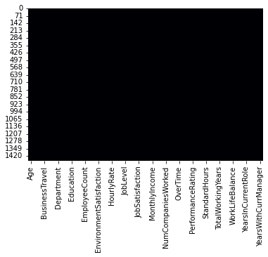
Experimental Study
All the data features may not perform equally in all study cases and analysis. Each feature may exhibit each behavioural pattern. So not all the features are extremely good together and some of the feature together would be good. For example, employee age and job engagement are positively correlated. So, this together data might be very helpful for analysing.
The heat map of the data set is found to be optimal without any null values after the pre-processing stage as shown in figure 2. Figure 1 - Heatmap

Slide 16
Experimental Study
The mean values of all the features are analysed. It is then divided to cases of Retention and Attrition faced Employees
The hourly, Monthly and Daily Rate display graphs that are usually found in time series. These graphs change with respect to time
Attrition is found in all the age groups. Between group 30 to 34, highest number of employees left the organization.
Employees at Travel Frequently have a 25% chance of leaving the organisation in terms of attrition rate
We establish a new data frame in order to display the correlation matrix.
To prevent data leakage, we therefore discard anything not contained in the training data.

Slide 17
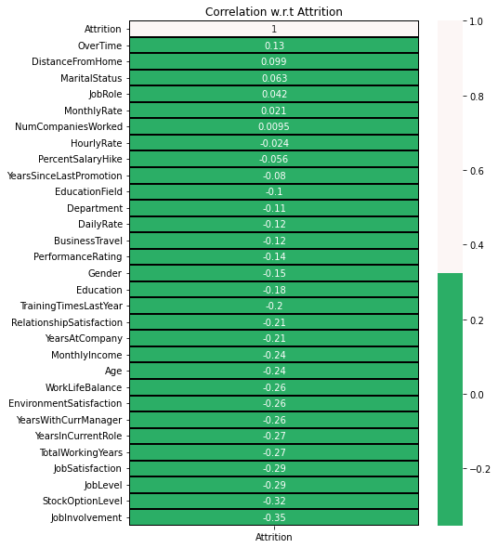
Correlation matric Figure 2 – correlation matrix

Slide 18
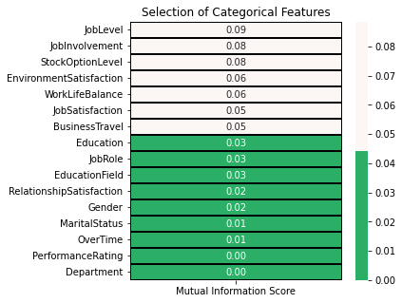
MUTUAL INFORMATION TEST
Figure 3 Mutual information test

Slide 19
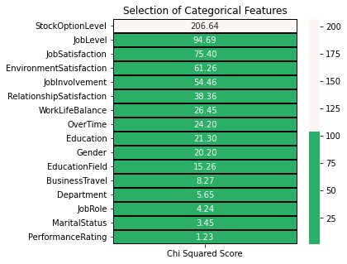
CHI SQUARED TEST
Figure 4 Chi squared test

Slide 20
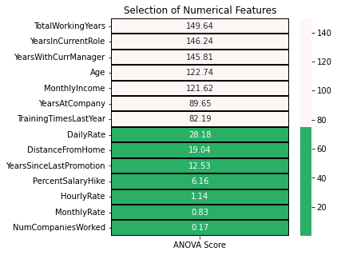
ANOVA TEST
Figure 5 ANOVA Test

Slide 21
ANOVA, chi squared, Mutual Inormation test
With categorical features, the Mutual Information Score of Attrition shows extremely low results. The aforementioned scores indicate that none of the traits should be used for modelling.
We shall remove the following characteristics from the aforementioned Chi Squared Score Test:
Performance Rating, Department, Job Role, Education Field, Business Travel, Marital Status, and Gender
eliminate the following features from the aforementioned ANOVA Score Test:
Monthly Rate, Hourly Rate, Number of Companies Worked, Percent Salary Increase, Years Since Last Promotion, Distance from Home, and Daily Rate.
By removing the characteristics based on the aforementioned statistical tests, we prepare the datasets for data scaling.

Slide 22
Conclusion
HR analytics is fast becoming a desired addition to HR practices.
Data that is routinely collected across the organization offers no value without aggregation and analysis, making HR analytics a valuable tool for measured insight that previously did not exist.
But while HR analytics offers to move HR practice from the operational level to the strategic level, it is not without its challenges.
Using HR analytics, we can make; More accurate decision-making Strategies to improve retention Employee engagement can be improved by analyzing data about employee behavior
Such as how they work with co-workers and customers, and determining how processes and environment can be fine-tuned.
Recruitment and hiring can be better tailored to the organization’s actual skillset needs by analyzing and comparing the data of current employees and potential candidates.
What so ever, many HR departments lack the statistical and analytical skillset to work with large datasets.
Also, different management and reporting systems within the organization can make it difficult to aggregate and compare data.
HR Analytics in one case can make all the difficulties overcome, this will be again fine-tuned by implementing new age technologies like cloud, big data and more

Slide 23
Future Enhancements
Every project needs a future enhancement.
The future enhancement of this project is adding a new feature.
The feature are always good in the data set
But , following the recession in 2022, employees mainly form IT field are getting lay-offs.

Slide 24

Lay-Offs
Lay – offs are usually very misunderstood theses days.
This misunderstanding would lead to panic in young working community.
After a detailed research, I’m concluding that layoffs are done only for;
Bench people, Employee without skill upgrade, Employees working on same technology for five plus years, Employees doing parallel jobs, Employees working from home.
Including these much of features would help this project far more
Figure 6, Layoffs

Slide 25
Did You Know?
A n IT organization has expelled 3000 employees in a single night! The reason is – “Employees are availing work from home and doing parallel jobs for multiple companies”.
Another IT chair person have recently said that, employees are being so lazy in working from home.

Slide 26
References
https://doi.org/10.1007/s11612-021-00548-y
https://doi.org/10.34104/cjbis.021.029037
https://doi.org/10.1016/j.hrmr.2020.100795

